Slide 1
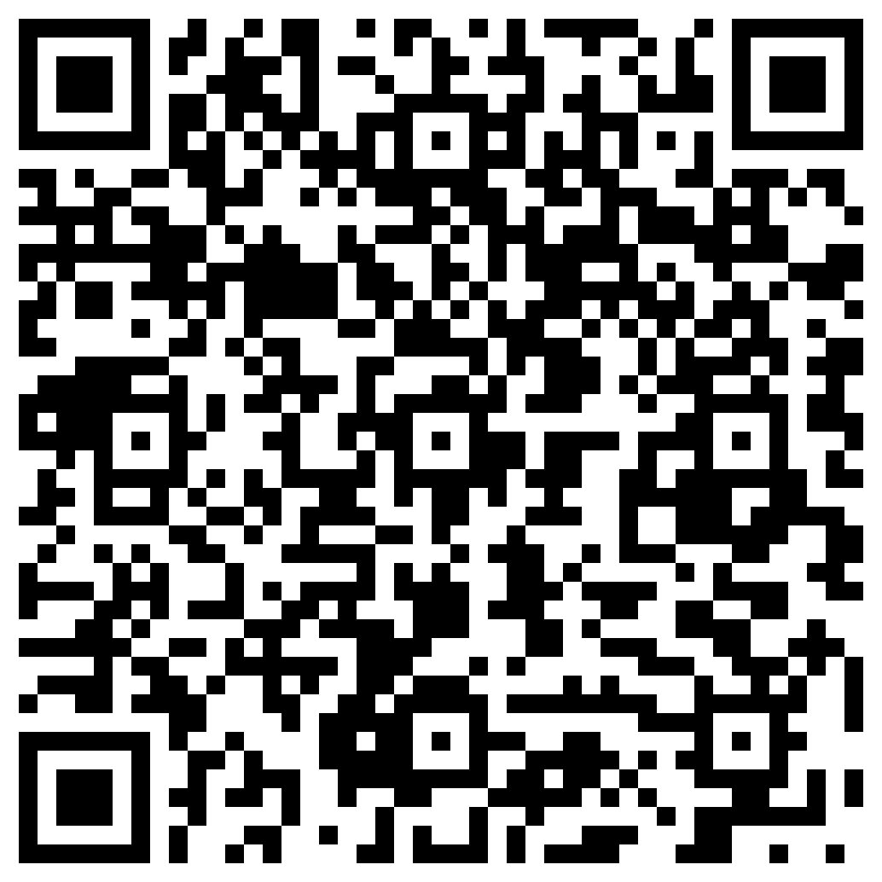
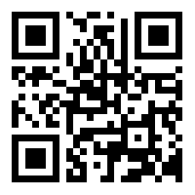
Financial Wellness for Cooper Residents and Fellows Fall 2023
Jay Weinberg, CLU, ChFC
PGY1 Financial Solutions
jay@pgy1.com
(609) 432-8862
Complete our “New Client Questionnaire” at www.pgy1.com
Scan to add Jay to your contacts
Questionnaire

Slide 2
Financial Planning Items
Student Loan Repayment Strategies
Tax Filing Considerations
Disability Insurance
Physician Home Mortgages
Life Insurance
IRA’s and Retirement Planning

Slide 3
Government Student Loans New “SAVE” Repayment Plan
SAVE replaces REPAYE and is the new default plan. Those on REPAYE will automatically get benefits of SAVE program.
Lowest monthly payment of all IDR plans.
Higher poverty line exemptions.
Full unpaid interest subsidy (meaning your balance won’t increase while on SAVE plan).
Tax filing status will not impact payment amount calculations (as it previously did with REPAYE and other plans).

Slide 4
Example of SAVE for a Resident
$200,000 of Govt. Loans @ 6% = $12,000 Annual Interest
$250 Per Month Payment = $3,000 Annual Payment
Unpaid Interest = $9,000
Loan Amount Stays at $200,000
All of your Unpaid Interest is Subsidized
Are You A Candidate?

Slide 5
SAVE Examples
If your SAVE payment is $0, then 100% of your interest is subsidized (regardless of interest amount and/or interest %). Common Scenario for Interns
If your SAVE payment is $250 and your interest is $1,500, then your interest subsidy is $1,250. Common Scenario for Residents and Fellows and 1st year Attendings.
If your SAVE payment is $1,500 and your in interest is $1,500, there is no interest subsidy. Common Scenario for Attendings.

Slide 6
Public Service Loan Forgiveness (PSLF)
Government Loans
Working for Government or Non-Profit Entity
120 “Qualifying” Payments (which do not have to be consecutive)
* Submit your “Employment Certification Form” annually to ensure you are clocking time.

Slide 7
Private Refinance Makes Sense For Those Who:
Are Not “Banking” on PSLF
Have Govt. Loan Interest Rates >6%
Have High Interest Rate and/or High Payment Private Loans
Want to Lock In a Lower Interest Rate for the Long Term
Interest rates on private refinances fluctuate based on interest rate environment and can be more/less favorable over time.

Slide 8
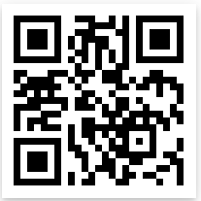
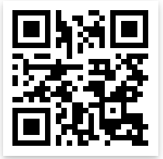
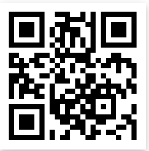
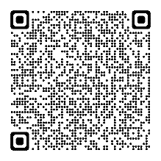
Student Loan Refinance Links
https://laurelroad.com/refinance-student-loans/?jwapp
http://sofi.com/AtlanticPensionPhysicians
http://sofi.com/app
http://iowastudentloan.org/jayw
They accept Non Title-IV Loans

Slide 9
Factors To Consider When Choosing The Right Disability Policy
Definition of Disability – Own Occupation
Group Disability Policies Compared To Individual Policies
Future Increase Options Without Medical Questions
Policy Differences in Florida, California, Arizona & Nevada
Medical Underwriting & Financial Underwriting
Special Policy’s that Don’t Require Medical Questions
Reasons To Secure Coverage While “In Training”
“For Physician” Websites – Pro’s and Con’s

Slide 10
Own Occupation That Fits Your Specific Needs
Medical Specialty Specific True Own Occupation – That Accounts For “Surgical Procedures” and “Hands on Patient Care”
Medical Specialty Specific
True Own Occupation / Regular Occupation / Your Occupation
Modified Own Occupation
Transitional Occupation
Medical Definition
Any Gainful Occupation

Slide 11
Group Disability Insurance v. Individual Disability Insurance
Taxation
Portability
Contract Language
Coverage Amounts and Caps

Slide 12
DISABILITY INSURANCE SHORT TERM v. LONG TERM
WHEN DO BENEFITS START?
Benefits Begin 5-10 Days After Disability
Benefits Begin 3-6 Months After Disability
3-6 Months Of Benefits
Until Age 65
HOW LONG DO BENEFITS LAST?

Slide 13
Ability to Increase the Coverage Amount in the Future Without Answering Medical Questions Based On Your Health TODAY
“Favorable”
Guardian *
Ameritas
Mass Mutual *
“Mandatory Requirements to Keep Feature on Policy”
Principal
Standard *
Guardian *
Mass Mutual *
Ameritas *
* = Company offers both options, depending on the specific policy

Slide 14
Different States – Different Pricing/Policy Wording
If you are MOVING to Florida,California, Arizona or Nevada –
You should consider beginning the process of securing a policy before moving to these states. Most companies have higher pricing in these states.
If you do NOT have a policy and plan to LEAVE Florida, California, Arizona or Nevada –
It would be in your best interest to DO YOUR HOMEWORK about the pros/cons of securing a policy in your current state compared to waiting until you move to the new state.

Slide 15
MEDICAL UNDERWRITING
Do you have any pre-existing medical or psychological conditions?
What is your current health?
Have you had any surgeries in the past?
What Prescriptions are in the pharmacy database?

Slide 16
“No Medical Questions Asked” Individual Disability Insurance Policies
This makes sense when you have medical or psychological information in your medical file
Does Not make sense if you are “clean as a whistle”
We have exclusive offers nationwide and keep a list of 100+ programs with similar offers through other insurance professionals.

Slide 17
Medical/Psychological Items that Can Impact Securing a Comprehensive Disability Policy
Treatment/Counseling for Mental Health (Anxiety, Depression, Substance, Eating Disorder, Sleep Disorder, Talk Therapy)
Prescriptions in the Pharmacy Database
Musculoskeletal or Hardware Implanted from Previous Injury
Cancer
Digestive Issues
Reproductive System Issues
Autoimmune Issues
COVID
Syncope Episodes
Diabetes
Emergency Room Visits
Fatigue
Vision Issues
Hearing Issues
Family History
Roughly 50% of Residents Have Information in Their Medical File that Can/Will Impact Their Ability to Secure a “Clean” Disability Policy.

Slide 18
Guardian Guaranteed Standard Issue Disability Insurance Coverage for Cooper House Officers
Medical Specialty True Own Occupation Policy
No Medical Questions Asked – Guaranteed Issue
There are NO price increases/surcharges.
Ability to lock in an affordable policy now with the option and ability to increase your coverage later with no health questions.
Other insurance agents do not have access to this policy.
If you previously applied for Disability Insurance it may make you ineligible for this offer. Contact us before speaking to other agents.
This offer is not endorsed and not sponsored by Cooper and is independent of any benefits offered by Cooper.
We have exclusive offerings at many other institutions in the area: Jefferson, UPENN, Rowan, Einstein, Temple, PCOM, Cooper, Lehigh (coming soon), Inspira (coming soon) and Geisinger (coming soon). Contact us for more details.

Slide 19
Reasons to Secure a Policy ASAP
Lock in a “starter policy” now, but have the “balloon option” to increase the coverage amount later, without having to answer any medical questions.

Slide 20
RED FLAGS Associated With Disability Insurance!
Page Grids That Map Out Multiple Policies are Misleading, Inaccurate and Approved by Insurance Companies or State Insurance Commissioners
Insurance Professionals That Represent Only 1 Company
If The Cost Seems “TOO GOOD TO BE TRUE”, It Probably Is

Slide 21
Where To Begin The Process To Secure A Comprehensive Disability Insurance Policy
www.pgy1.com

Slide 22
Highlights Of Physician Mortgages
Competitive Interest Rates
0% or 5% Down Payment
No PMI (Private Mortgage Insurance)
Favorable Debt to Income Calculations for Those With Student Loans

Slide 23
Life Insurance
Are You Married?
Do You Have Dependents?
Do You Have Co-Signers on Loans?
Term Life Insurance
10,15,20,25,30 & 40 Year
Permanent Life Insurance
Whole Life, Variable Life, Universal Life, Indexed Life

Slide 24
Roth IRA’s
ROTH IRA’S
Annual Income
Tax Filing Status
Contribution Limits

Slide 25
Key Components Within a Resident’s Financial Plan
Student Loans
Disability Insurance
Home Ownership
Life Insurance
Retirement
Rank These Items Based Upon Your Specific Situation

Slide 26
Would You Like To Set Up A Complimentary Consultation?
If you would like to initiate a conversation, please do not hesitate to contact Jay at (609) 432-8862
Complete our New Client Questionnaire at www.pgy1.com
To begin the application process for a comprehensive policy, please visit my secure web portal at www.disabilityquotes.com/weinberg

